Slide 1


Day – 29 : Joins in SQL - II
Course created by Satish Dhawale | www.skillcourse.in

Slide 2
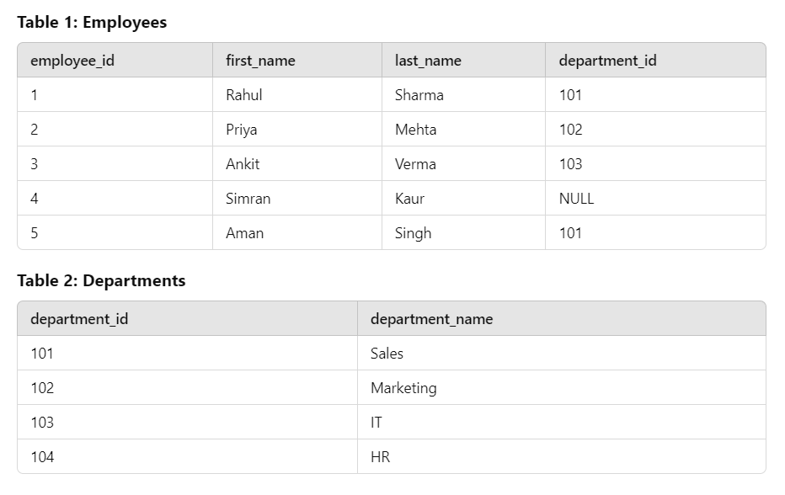
To explain joins, we’ll create two tables: Employees3 and Departments.

Slide 3
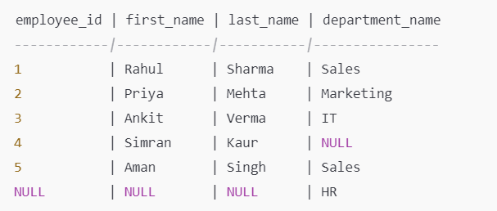
4. FULL OUTER JOIN - Retrieve all Employees3 and departments, including non-matching records from both tables
SELECT
e.employee_id,
e.first_name,
e.last_name,
d.department_name
FROM
Employees3 e
FULL OUTER JOIN
Departments d
ON
e.department_id = d.department_id;
OUTPUT →
Employees3
Department

Slide 4
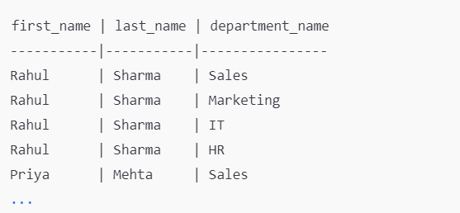
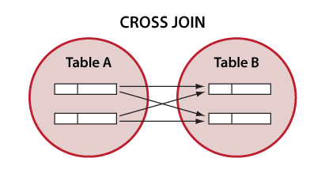
5. CROSS JOIN- Retrieve all possible combinations of Employees3 and departments.
SELECT
e.first_name,
e.last_name,
d.department_name
FROM
Employees3 e
CROSS JOIN
Departments d;
OUTPUT →

Slide 5
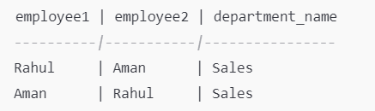
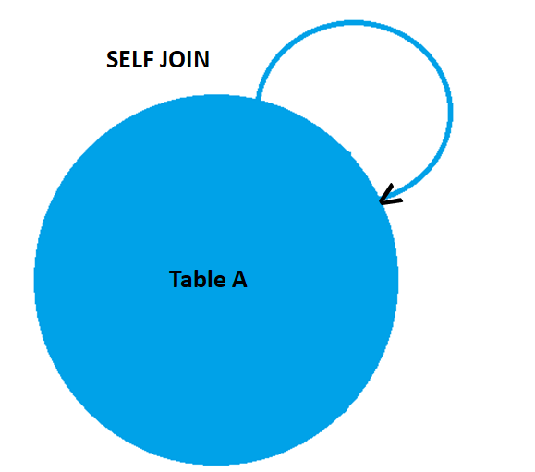
6. SELF JOIN- Find Employees3 who share the same department.
SELECT
e1.first_name AS employee1,
e2.first_name AS employee2,
d.department_name
FROM
Employees3 e1
JOIN
Employees3 e2
ON
e1.department_id = e2.department_id AND e1.employee_id != e2.employee_id
JOIN
Departments d
ON
e1.department_id = d.department_id;
OUTPUT →

Slide 6
SELFT JOIN - Find Employees3 who share the same department.
OUTPUT →

